Slide 1
Energy Demand Reduction
Group 1
Gerald Mace
Michael Wolak
Nate Crispel
Raghav Agarwal
Tyler Heinrich
Notes:
Our motivation behind this presentation is to share knowledge on the benefits and effects of participating in energy demand reduction. Ultimately the strategies we discuss can lead directly to compounding cost savings.
In a similar way, compounded energy savings can lead to slow pressure that will curb the ever increasing global energy demand. If households engage in smart clean and green methods of energy demand reduction, we can more easily achieve energy sustainable

Slide 2
Table of Contents
Background and Purpose
Part A: Energy Demand Reduction
Idea 1: Programmable Thermostat
Idea 2: Geothermal Heat Pump
Idea 3: Window Attachments
Part B: Impacts of Adding an Electric Car
Notes:
Brief history of Energy Demand Reduction and its purpose
Explore ideas that households can implement to reduce energy usage, effectively engaging in energy demand reduction
These ideas are characterized by improvements in efficiency or energy generation
Discuss how adding an electric car might impact cost findings from A

Slide 3
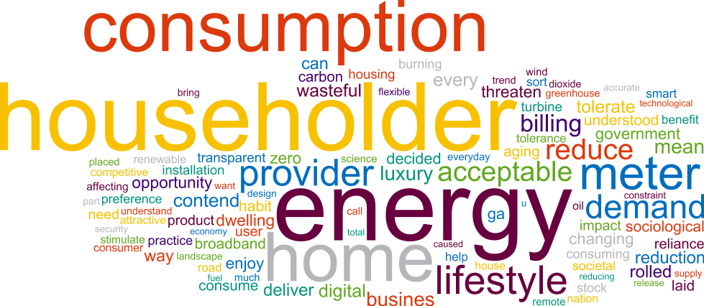
A Background and Purpose
Industrial Revolution - widespread energy use
Seemingly limitless resources
Energy source driven by cost and safety
1973 Oil Crisis
Limited resources!
Drive down demand, spend less
Modern conservation motif
Notes:
Coal was a common heat source of homes until it was replaced by oil (for safety reasons, not necessarily cost)
US oil production couldn’t meet demand so Oil had to be imported from OPEC
1973 represented a shock that energy sources aren’t freely available at a convenient price
When we demand less energy, we won't have to spend as much
In addition to cost savings, conservation of natural resources drives much of energy demand reduction
People feel a responsibility to use alternative energy sources which saves money in the long term but also

Slide 4
Idea 1 Programmable Thermostat
First oil crisis in the United States in 1973 inspired national attention at energy consumption.
The first energy code written in 1978 for the state of California required installation of ‘setback’ thermostats in new houses.
A study in 1970 suggested that a daily 8-hour reduction in temperature during sleeping hours could bring a 1% reduction in natural gas consumption for each Fahrenheit degree.
In 1995 EPA started promoting programmable thermostats to save anywhere from 10 to 30% off a home’s heating and cooling bill

Slide 5
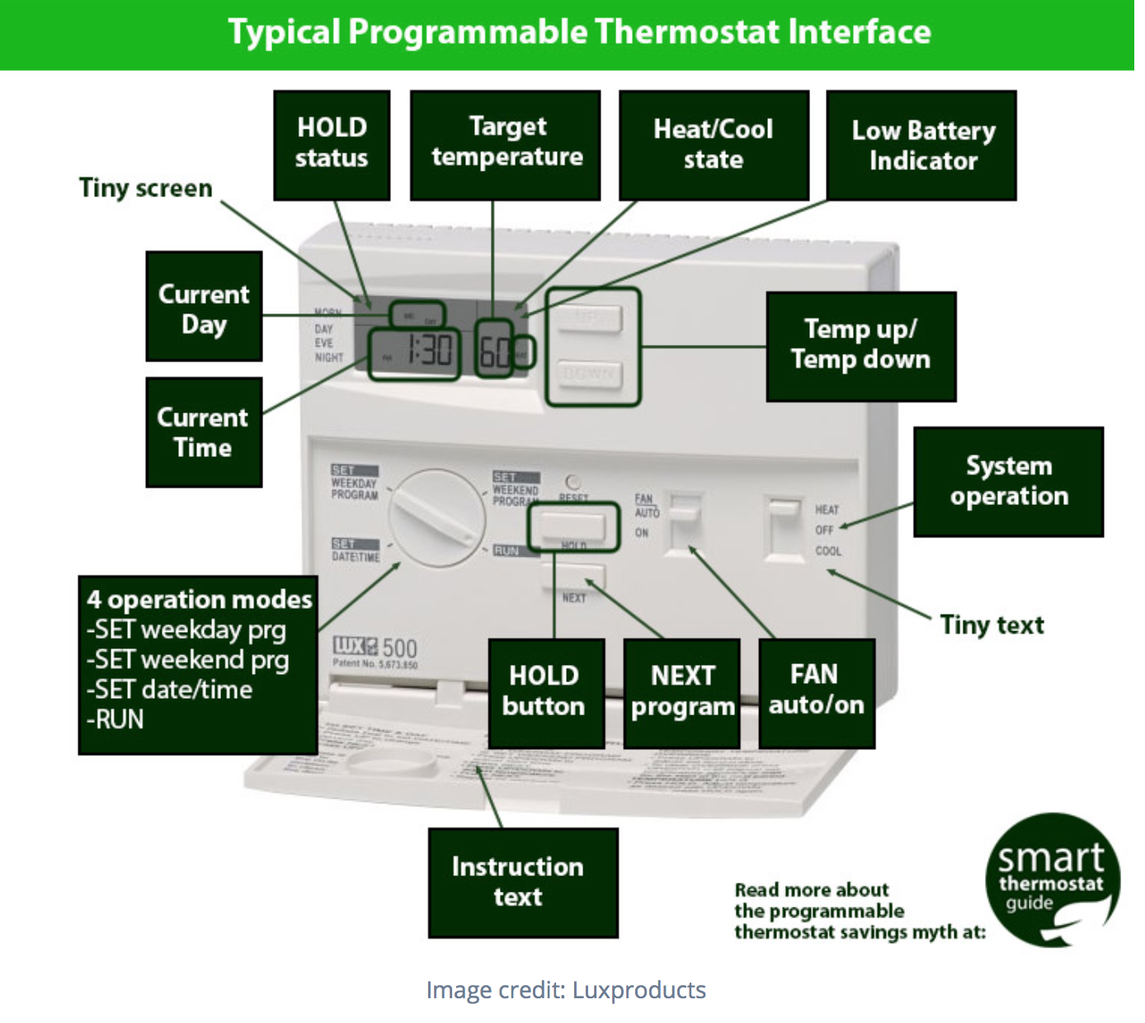
What is a programmable thermostat?
A programmable thermostat is a thermostat which is designed to adjust the temperature according to a series of programmed settings that take effect at different times of the day. Programmable thermostats may also be called setback thermostats or clock thermostats.

Slide 6
Benefits of using a programmable thermostat:
Makes it easy to lower the temperature in our home while we are away or sleeping.
The more frequent use of lower temperatures during night will result in measurable and significant energy and cost savings.
For example if a normal household uses 50 gigajoules of energy each year for heating and the owner decided to lower the temperature by 5 degree Celsius at night. This adjustment will save 5 gigajoules of natural gas each year.

Slide 7
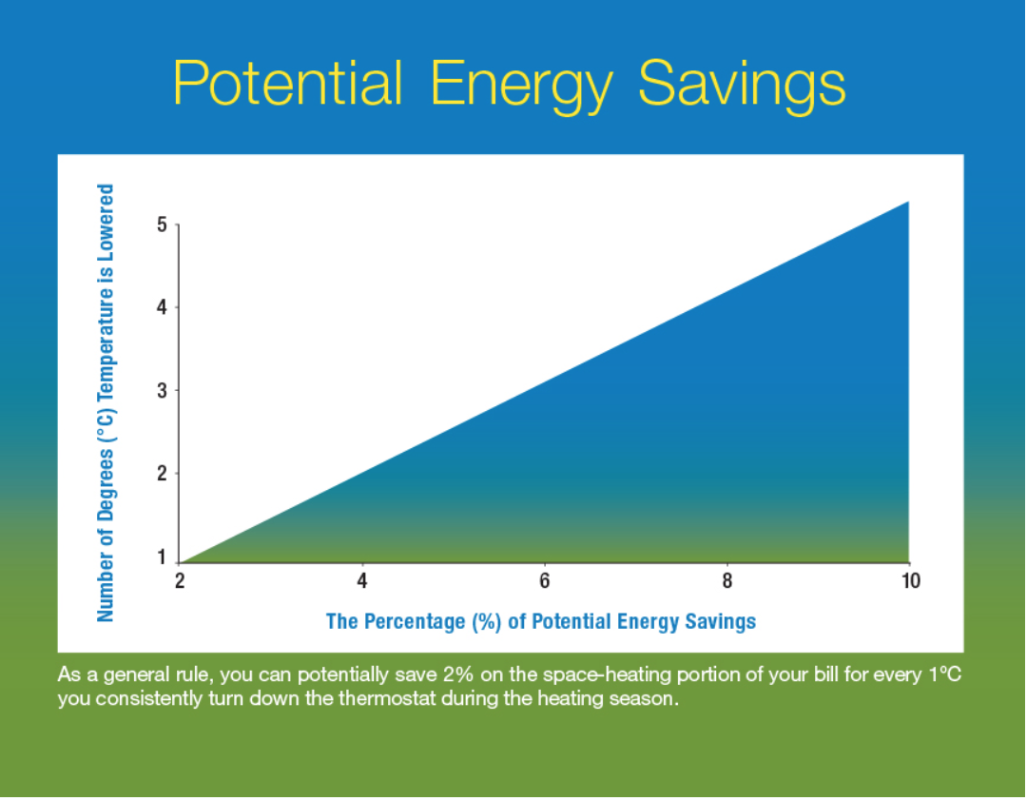

Slide 8
Choosing and Programming a Programmable thermostat.
Most programmable thermostats are either digital, electromechanical or a mixture of two. Digital thermostats offer the most features in terms of multiple setback settings, overrides, and adjustments for daylight savings time, but may be difficult for some people to program. Electromechanical systems often involve pegs or sliding bars and are relatively simple to program.
The programming of a particular thermostat depends on the sleep and wake cycle of the person. For example if a person prefers to sleep at a cooler temperature during the winter then he should start the temperature setback a bit ahead of the time before going to bed. Similarly, if there is a time during the day when the house is unoccupied for four hours or more, it makes sense to adjust the temperature during those periods.

Slide 9
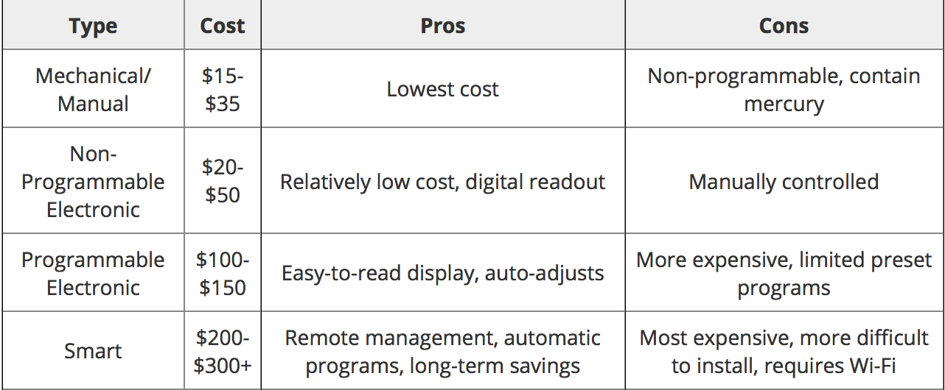
Cost Analysis
According to the Energy Information Administration (EIA), energy costs for heating and cooling together comprise about 42% of consumer home energy expenditures, on average.Twenty-five million households currently have a programmable thermostat and approximately 91 million households use thermostats for their home heating, and many of these households offer a market opportunity for programmable thermostats.

Slide 10
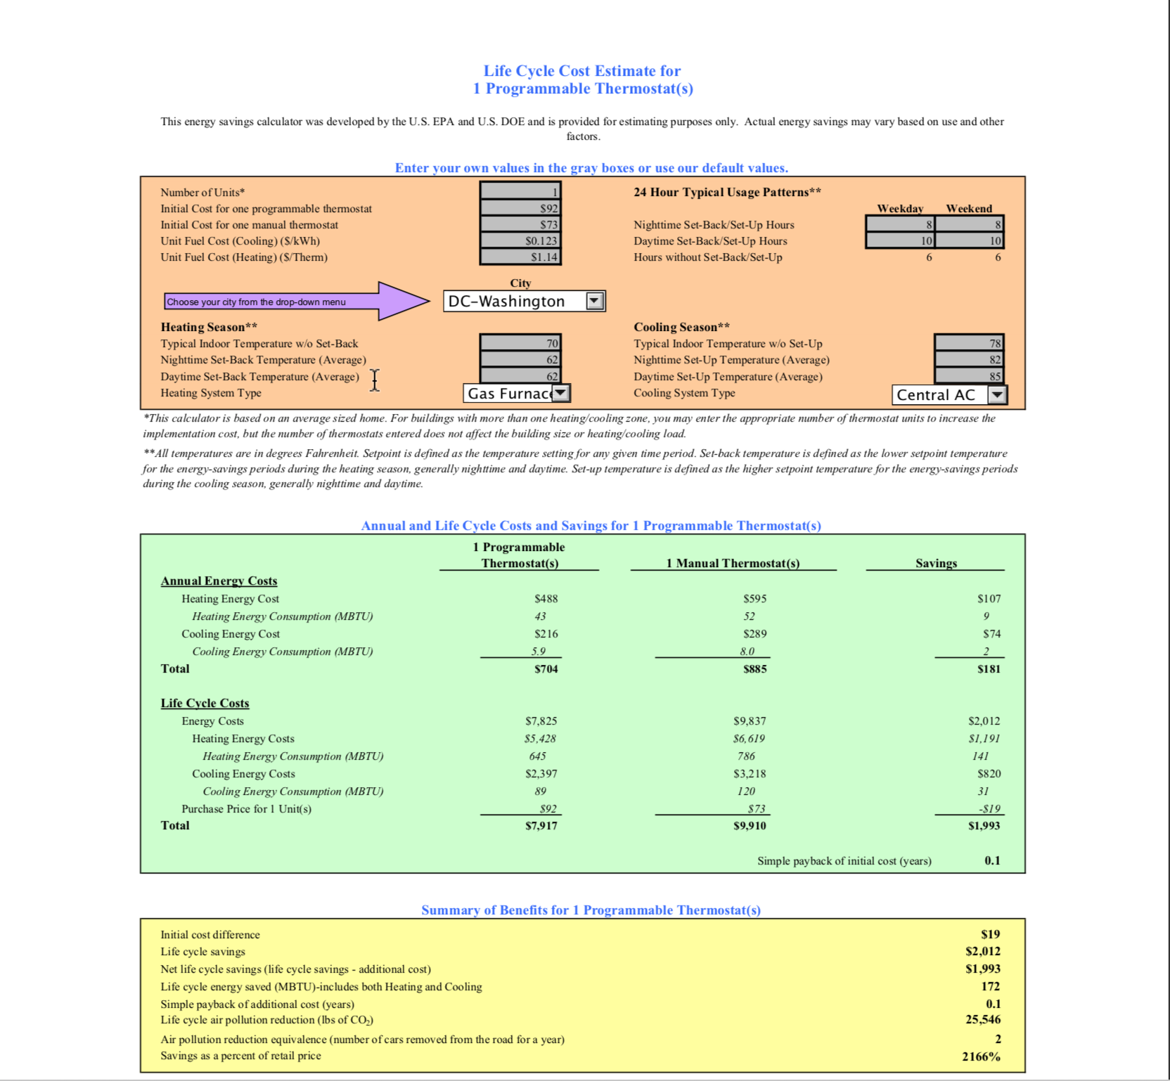

Slide 11
For the analysis, we assumed the number of units installed to be 1 and the initial cost of a programmable thermostat to be $92 and initial cost for a manual thermostat to be $73 which results in an initial cost difference of $19.
After doing the analysis , a programmable thermostat on an average will result in net life savings(life cycle savings - additional savings) of about $1993 and life cycle energy saved will be around 172 MBTU(including heating and cooling) based on the assumptions made before the analysis. On average a thermostat can last for ten years. So total energy saved per year will be around 5041 kWh/year.

Slide 12
Government Incentives
The US government currently doesn’t provide any incentives for installation of programmable thermostats. But there are other organisations that offers rebates for replacing the manual thermostats with the programmable ones. Environmental Law and Policy Centre a public interest environmental legal advocacy and eco-business innovation organization is one such organisation provides rebates for installation of programmable thermostats. ELPC offers eighteen different thermostats for $100 in rebates for customers with WiFi, central air, and a furnace. Energy star is another organisation that offers rebates for various certified thermostats.

Slide 13
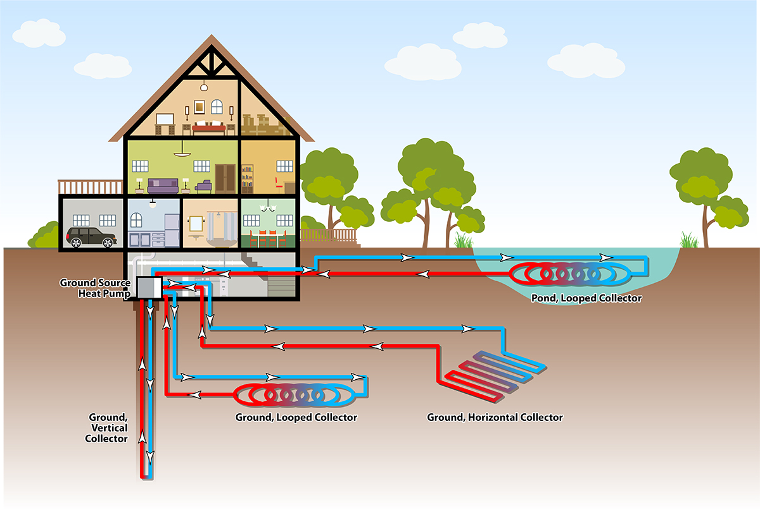
Idea 2: Geothermal Heat Pump
Geothermal energy is usually associated with very high temperatures deep underground.
Residential systems work on a slightly different principal.
The near constant lower temperatures allow the soil to be used as a heat sink or heat source.
This reduces electricity or energy use significantly
http://www.hollidayheating.com/geo-thermal/

Slide 14
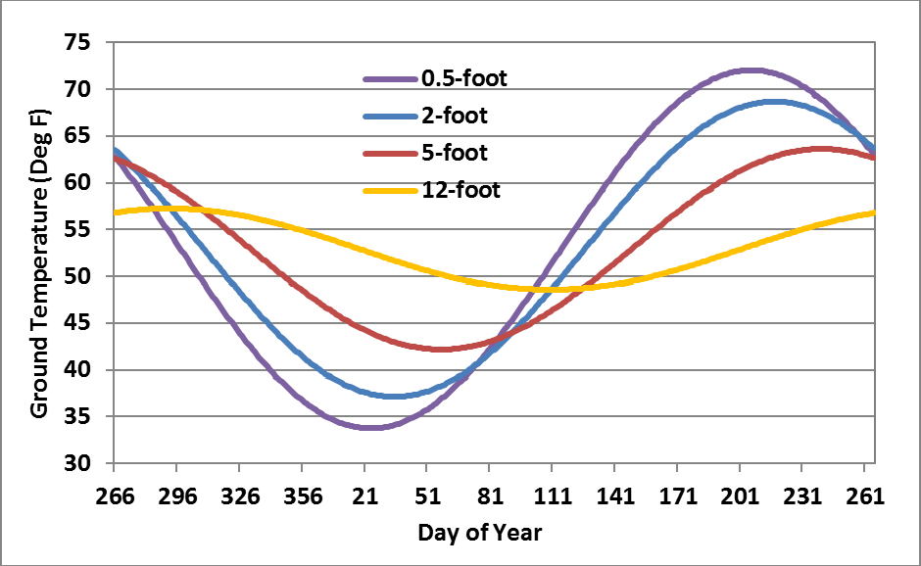
Idea 2: Geothermal Heat Pump
The deeper you go, the more constant the temperature.
There is also a lag time that increases with depth.
In Maryland, avg. soil temp is around 57℉ at 10 feet
https://igws.indiana.edu/Geothermal/HeatPumps

Slide 15

Idea 2: Geothermal Heat Pump - Costs
The installation of a new system can be costly, sometimes over $10,000, depending heavily on the depth and size of the system.
This can be several times as much as a traditional heat pump of the same size.
However, energy savings can be as much as 72%
https://www.grainger.com/product/38GM25?cm_sp=Product_Details-_-Products_Based_on_Your_Search-_-IDPPLARECS&cm_vc=IDPPLARECS

Slide 16

Geothermal Heat Pump - Government Incentives
The Maryland state government offers various incentives for geothermal systems
Residential Clean Energy Grant for new GHC Systems - $3000
Access to Renewable Energy Credits (RECs)
Access to low interest loans of up to $20,000

Slide 17
Geothermal Heat Pump - Energy Savings
The EIA states that, in 2015, energy expenditure per household in the Middle Atlantic was 23.2 million Btu for heating and 10.7 million Btu for air conditioning[3].
Assuming an energy savings of 50%:
(23.2 million Btu + 10.7 million Btu)*1 kWh3412.14 Btu *.5 = 4967.6 kWh savings/year
The EIA estimates the average energy cost in Maryland to be 12.21 cents per kWh. At this rate, the yearly savings for a residential user would be $606.54/year.

Slide 18
Geothermal Heat Pump - Total Cost Analysis
Initial GHC Cost - $12,000
3 ton traditional heat pump - $4500
Government Grant - $3000
Yearly savings - $606
Net cost of GHC compared to traditional - $4500
In about 7.5 years, the energy savings will pay for the GHC system

Slide 19
Geothermal Heat Pump - Total Cost Analysis
Net life cycle energy savings will be 12.5 years*4967.6 kWh = 62095 kWh
Net lifetime savings - $7582

Slide 20
Idea 3: Window Attachments
In buildings, a large portion of the heating and cooling loads come from the exterior surface, or “building envelope”
According to the department of energy, an average of “about 30% of a homes heating energy is lost through windows.”
This is due to the high U-value or very low insulation properties of windows
Even with modern windows featuring double panes and special films, 76% of direct sunlight will enter the building as heat in the cooling season
To combat this, we can use window attachments to reduce direct sunlight on windows

Slide 21
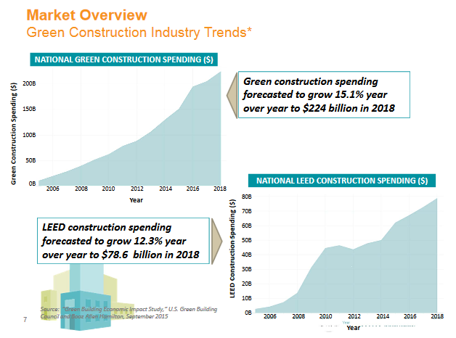
Window Efficiency Government Incentives
Various building codes used regarding sustainability including LEED (Leadership is Energy and Environmental Design) and ASHRAE 90.1.
These codes are continually updated and enforced by the US government to promote sustainability including more efficient window options.
A market report by the DoE was conducted in 2016 on window shading and attachments
‘Green products and interest by consumers is an important trend and will drive future energy reports’
They predict construction spending on more sustainable alternatives will increase significantly

Slide 22
Government Incentives Continued
An example of specific incentives for better window films is as follows:
Prescriptive Incentive Programs
Rebate amounts were in an amount of money per sq. ft. of window space
Tiered rebate dollar amounts based on the improvement of the SHGC (solar heat gain coefficient) post install
Custom Incentive Programs
Rebate amounts based on projected annual saving ($/kWh) through building energy modeling analysis

Slide 23
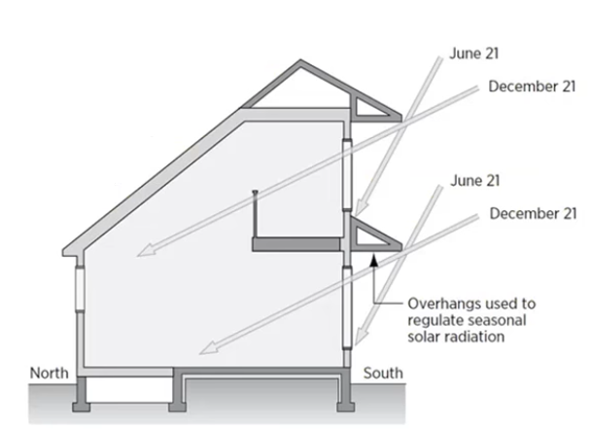
Window Overhangs
When discussing energy efficient window options there are many such as glazings, blinds, shading, etc., I’m going to focus on one option today
Window overhangs can be utilized on SOUTH facing windows due to different elevations of the sun at different times of the year
Low sun in cold months allows heat gain through windows
High sun in hot months keeps exterior heat from penetrating windows

Slide 24
Window Overhangs
Depending on areas climate you can design dimensions that best fit needs
In moderate, 4 season climate, a usual protrusion length will be at the intersection of the winter and summer solstice
One con: during “shoulder months” the sun is at the same height at different times of year when different cooling needs are required

Slide 25
Window Overhangs
Pros:
One time installation (usually during construction)
Lets natural light in
Low maintenance (passive energy design)
Reduction in building loads
Better building efficiency
Cons:
During “shoulder months” the sun is at the same height at different times of year when different cooling needs are required

Slide 26
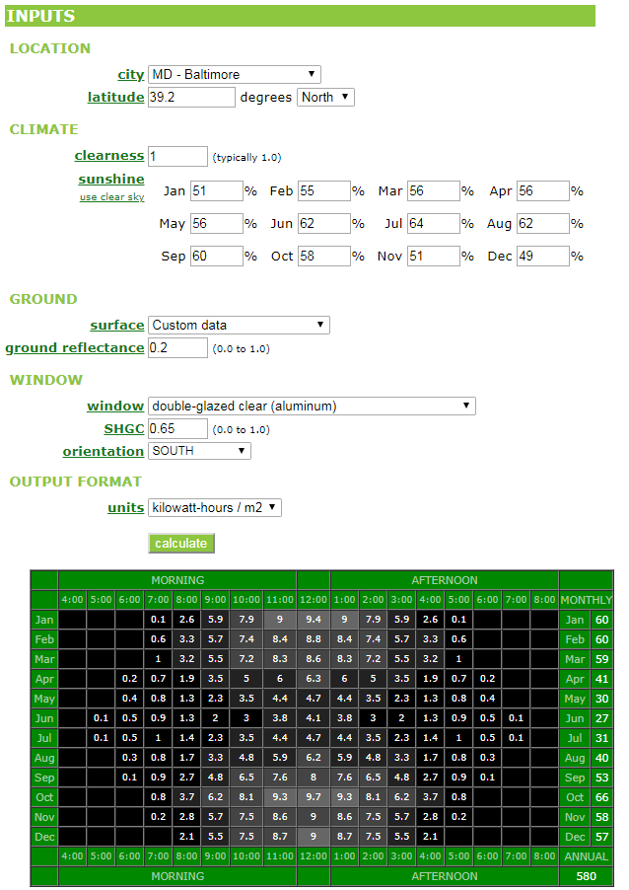
Cost Analysis
Heat Gain control (One window):
Annual total kWh/m^2: 580

Slide 27
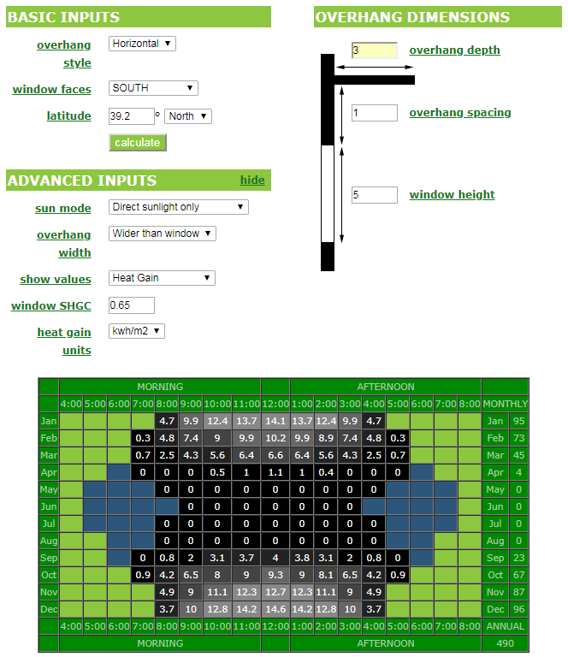
Cost Analysis
Heat Gain with overhang (One window):
Annual total kWh/m^2: 490
We are saving about 90 kWh per window per year
Assuming a household had 8 - 12 south facing windows, this would equate to around 1000 kWh saved annually

Slide 28
Cost Analysis and conclusion
At 1000 kWh, this would save a monetary value of about $100 yearly
Over product lifetime this amounts to thousands of dollars
On a large scale basis we can assume 100 million south facing windows optimized fully will give an energy savings at a multi billion dollar scale and reduce the need for several gigawatt level power plants.
In conclusion window overhangs are one of many good options to increase window efficiency given that t is a one time install, low maintenance product that has minimal impact on a consumer's lifestyle.

Slide 29
Total Yearly Energy Savings of all Ideas
Initial Energy Use: 19782.3 kWh/year
Savings from Programmable Thermostat: 172 MBTU per 10 years or 5041 kWh/year
Savings from GHC: 4967.6 kWh/year
Savings from Window Coverings: 1000 kWh/year
Total Yearly Savings: 11,009 kWh

Slide 30
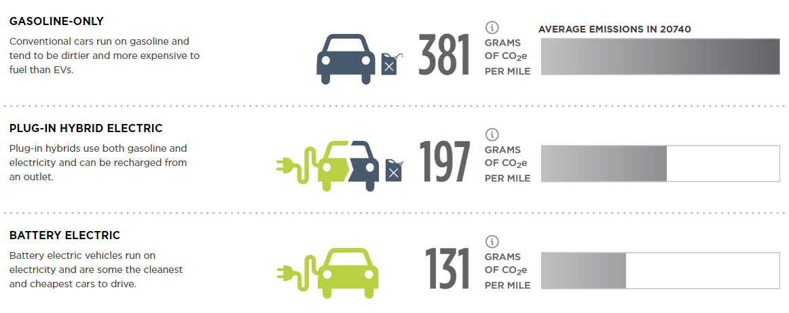
Part B: Impacts of Adding an Electric Car
Generally speaking, electric vehicles have high initial costs both monetarily and in their emissions due to the complexity of their assembly and sophisticated batteries. This is offset by their cheaper fuel costs and lower emissions per mile

Slide 31
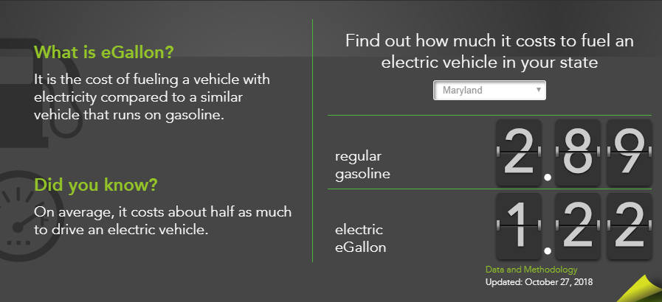
Price Per Mile relative to ICE Vehicles
EV’s don’t pay at the pump but pay through energy costs in the home. This is still cheaper per mile in Maryland compared to Internal Combustion Vehicles

Slide 32
Increasing the energy bill, but still getting a net gain in energy savings
Yes, adding an EV to the home is going to ultimately increase the energy bill...
But the savings in energy and money vs the alternative of driving an ICE are more than enough to justify the switch.
With the previous Energy reduction ideas, we could even cover the energy cost of the EV and still save

Slide 33
Energy Cost of EV’s
*Values were taken from the values given in HW 7 for Module 8 in the lecture*
Considering the results at the end of part A, and assuming the electric vehicle in question was a Tesla Roadster and the annual miles per year driven was 15600.
Energy = (15600 miles/year) / (5.6mi/kWh) = 2785.71 kWh/year

Slide 34
Results of Energy Reduction
This means that the GHC’s and programmable thermostats will save enough energy to compensate the charging of an electric car.
While the window coverings don’t save enough energy, the net gain of getting an electric vehicle is still enough of a benefit to justify the extra kWh used annually in your home to charge it.
While the energy savings isn’t simple to see or notice on an energy bill, it still exists in the reduced CO2 emissions and the savings in mileage vs. that of a ICE vehicle.

